Slide 1
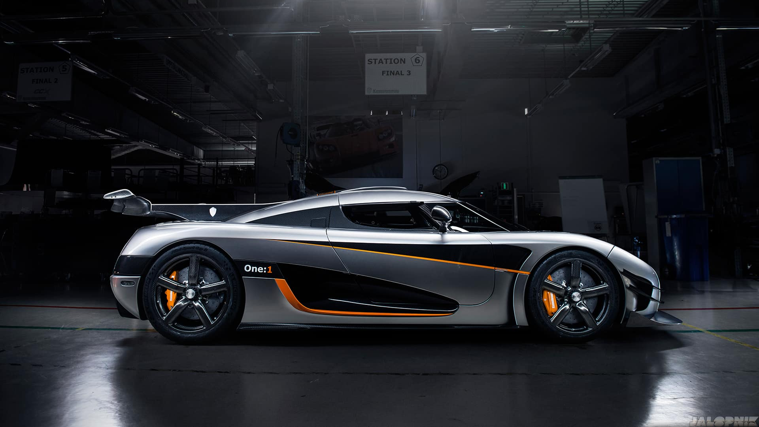
Koenigsegg one:1
By Haroon Baresh

Slide 2
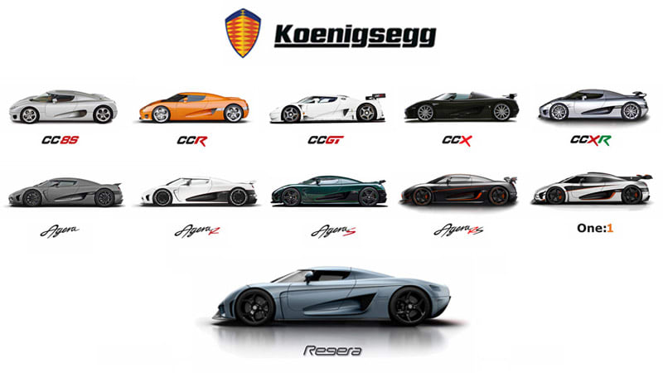
What is Koenigsegg
Koenigsegg is a company which produces hyper cars which are cars that are the best performing and superior cars in the market. The price of these cars can range between $4.8 million which is the Koenigsegg CCX Trevita which is also the most expensive and the Koenigsegg CC8S which is $ 585,000 after inflation.

Slide 3

What makes the Koenigsegg one:1 unique ?
Koenigsegg produced the first homologated production car with one megawatt of power which makes it the first production megacar.

Slide 4
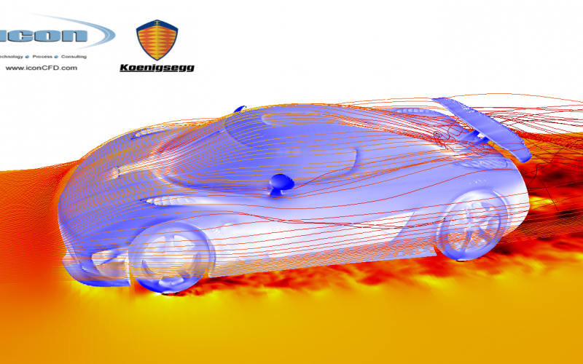
How was every part of the one:1 taken into account and how did they manage the weight ?
Trying to obtain a car with that curb weight to horsepower ratio can be very difficult however regardless of the difficulty it was achieved nonetheless. But how ?
In order to save 100 Kilograms of weight the team had to consider the carbon fiber monocoque with the new type of carbon fiber materials. Adding even more titanium fosters and exhaust ports and lexus glass on the roof. All these small bits eventually suffice to achieving the golden ratio.

Slide 5
Any questions ?
Thank you for listening

